Slide 1
Ensemble methods

Slide 2
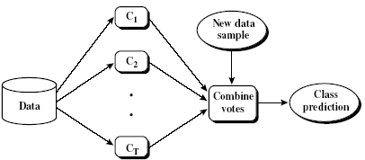
Ensemble Methods: Increase prediction accuracy using base Learners
Ensemble methods
Use a combination of models to increase accuracy
Combine a series of k-learned models, M₁, M₂, …, M_{k}, with the aim of creating an improved model M*
Popular ensemble methods
Bagging: averaging the prediction over a collection of classifiers
Boosting: weighted vote with a collection of classifiers

Slide 3
General Idea

Slide 4
Why does it work?
Suppose there are 25 base classifiers
Each classifier has error rate, ε = 0.35
Assume classifiers are independent
Probability that the ensemble classifier makes a wrong prediction:

Slide 5
Bagging: Boostrap Aggregation
Analogy: Diagnosis based on multiple doctors’ majority vote
Training
Given a set D of d tuples, at each iteration i, a training set D_{i} of d tuples is sampled with replacement from D (i.e., boostrap)
A classifier model M_{i} is learned for each training set D_{i}
Classification: classify an unknown sample X
Each classifier M_{i} returns its class prediction
The bagged classifier M* counts the votes and assigns the class with the most votes to X
Prediction: can be applied to the prediction of continuous values by taking the average value of each prediction for a given test tuple
Accuracy
Often significantly better than a single classifier derived from D
For noise data: not considerably worse, more robust
Proved improved accuracy in prediction

Slide 6
Boosting
Analogy: Consult several doctors, based on a combination of weighted diagnoses—weight assigned based on the previous diagnosis accuracy
How does boosting work?
Weights are assigned to each training tuple
A series of k classifiers is iteratively learned
After a classifier M_{i} is learned, the weights are updated to allow the subsequent classifier, M_{i+1}, to pay more attention to the training tuples that M_{i} misclassified
The final M* combines the votes of each individual classifier, where the weight of each classifier's vote is a function of its accuracy
The boosting algorithm can be extended for the prediction of continuous values
Compared with bagging, boosting tends to achieve greater accuracy, but it also risks overfitting the model to misclassified data

Slide 7
Adaboost (Freund and Schapire, 1997)
Given a set of d class-labeled tuples, (X₁, y₁), …, (X_{d}, y_{d})
Initially, all the weights of tuples are set the same (1/d)
Generate k classifiers in k rounds. At round i,
Tuples from D are sampled (with replacement) to form a training set D_{i} of the same size
Each tuple’s chance of being selected is based on its weight
A classification model M_{i} is derived from D_{i}
Its error rate is calculated using D_{i} as a test set
If a tuple is misclssified, its weight is increased, o.w. it is decreased
Error rate: err(X_{j}) is the misclassification error of tuple X_{j}. Classifier M_{i} error rate is the sum of the weights of the misclassified tuples:
The weight of classifier M_{i}’s vote is

Slide 8
Notation
Input:
D, a set of d class-labeled training tuples;
K, the number of rounds (one classifier is generated per round);
A classification learning scheme.

Slide 9
Adaboost
Output: A composite model
(1) Initialize the weight of each tuple in D to i/d;
(2) for i=1 to k do // for each round
(3) sample D with replacement according to the tuple weights to obtain D_{i};
(4) use training set D_{i} to derive a model, M_{i};
(5) compute error(M_{i}), the error rate of M_{i}
(6) if error(M_{i}) > 0.5 then
(7) reinitialize the weight to 1/d
(8) go back to step 3 and try again;
(9) endif
(10) for each tuple in D_{i} that was correctly classified do
(11) multiply the weight of the tuple by error(M_{i})/(1-error(M_{i}));
(12) normalize the weight of each tuple;
(13) endfor

Slide 10
To calssify tuple X
Initialize weight of each class to 0;
For i=1 to k do //for each classifier:
w_{i}= ;// weight of the classifier’s vote
c=M_{i}(X);// get class prediction for X from M_{i}
add w_{i} to weight for class c
Endfor
Return the class with the largest weight;

Slide 11
Regression tree
Decision tree for regression
Minimize expected variance in splitting a node

Slide 12
Reference links
Decision tree regression
gradient-boosting-explained
Math-in-gradient-boosting
Battle between random forest and gradient boosting
Explained-in-Chinese
Decision tree for regression

Slide 13

Decision Tree Splitting Method #1: Reduction in Variance
Reduction in Variance is a method for splitting the node used when the target variable is continuous, i.e., regression problems. It is so-called because it uses variance to decide the feature to split a node into child nodes.
Variance is used for calculating the homogeneity of a node. If a node is entirely homogeneous, then the variance is zero.

Slide 14
Steps to split a decision tree using reduction in variance:
For each split, individually calculate the variance of each child node
Calculate the variance of each split as the weighted average variance of child nodes (minimize expected variance)
Select the split with the lowest expected variance
Perform steps 1-3 until completely homogeneous nodes are achieved
To prevent overfitting, restrict a minimum number of samples in a child node. You can set this parameter.

Slide 15
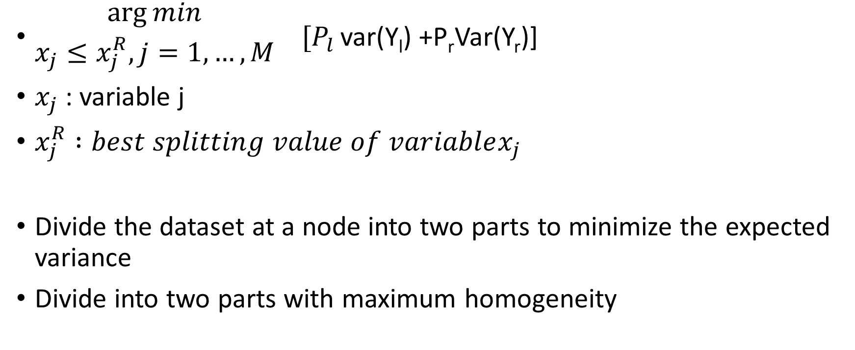
$\begin{matrix}\arg{min} \\ x_{j}{≤x}_{j}^{R}, j=1,…,M\end{matrix}$ $[P_{l }$var(Y_{l}) +P_{r}Var(Y_{r})]
$x_{j}$ : variable j
$x_{j}^{R} :best splitting value of variablex_{j}$
Divide the dataset at a node into two parts to minimize the expected variance
Divide into two parts with maximum homogeneity

Slide 16
X<=5.5
Split 1: X=(1+2)/2=1.5
X | Y
1 | 1
2 | 1.2
3 | 1.4
4 | 1.1
5 | 1
6 | 5.5
7 | 6.1
8 | 6.7
9 | 6.4
10 | 6
11 | 6
12 | 3
13 | 3.2
14 | 3.1
X=(5+6)/2=5.5
Mean=1.14
Var=0.112
Expected Var=1/14*0 +13/14 *(66.24/13)
= 66.24/14=4.73
Mean=3.9
Var=66.24
Mean=5.11
Var=18.74
Expected Var=5/14*(0.112/5) +9/14 *(18.74/9)
= 12.09/14=0.86
Notes:
因為expected var 5< expected var1 老師只是比較split1 / split5 但是你必須確認所有的split 但期末沒有這麼多時間 老師給的題目會很乾淨 他說的..
看Y 切在 X 切割用眼睛看 用決策後的左右平均數預測得到h1
F1 = f0+h1
殘差=y-f1
可以一直切得到新的殘差
每一層都會產生新的樹(h1 h2 h3 f1 f2 f3) 殘差會越來越小

Slide 17
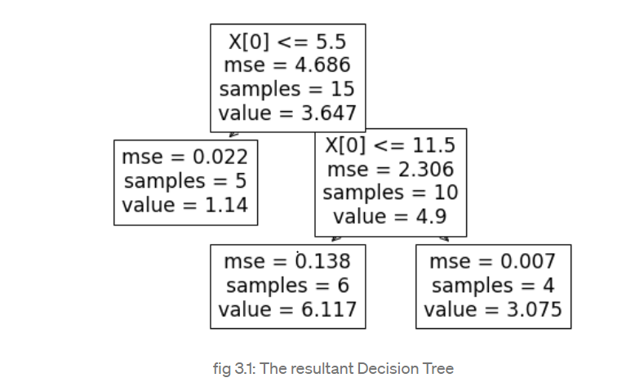
Notes:
有要做決策樹 / gradient boasting

Slide 18
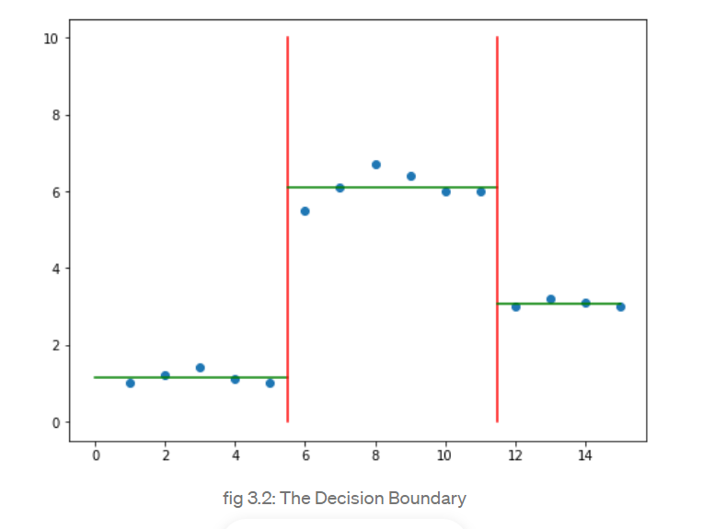

Slide 19

F0(x) uses a γ constant to predict

Slide 20

γ Is the mean of y_{i}

Slide 21
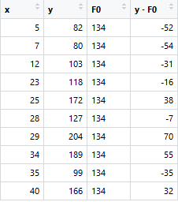
Residual y-F0

Slide 22
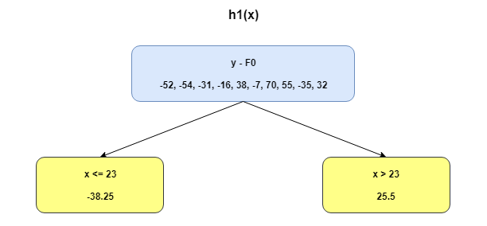
Build a regression stump to predict residuals

Slide 23
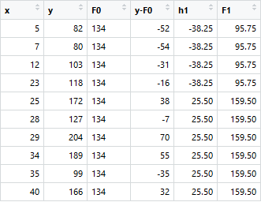
F1=F0+h1

Slide 24
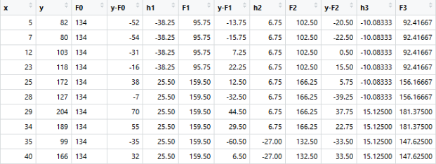
New residuals

Slide 25
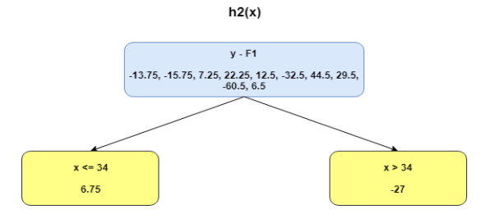
Build h2 to predict y-F1

Slide 26
F2=F0+h1+h2----additive model

Slide 27
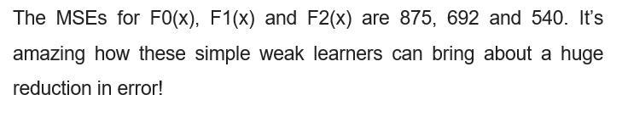
Reduce MSEs
Notes:
F0 f1 f2會變很多
可以加很多很多層 殘差就會越來越小

Slide 28


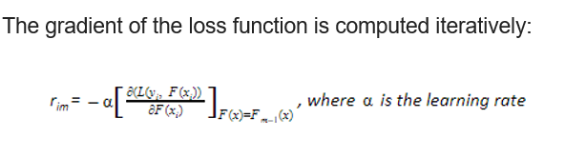
Why gradient?
So, the residual is the negative gradient!
Notes:
為何和梯度有關 因為殘差項 若是函數是上面的L
對F求微分時，(y-f) 是 殘差 就變成 (梯度) 等於 (負的殘差)
殘差項就是 t度 加負號
用 梯度向下法 是用 沿著負的剃度方向去修改他的值 梯度方向的反方向去修改
因為原定的learning rate =1 但真正的gradient boosting 就a (alpha 就不是1了)
如果考慮learning rate 就會 a * y-f0
Gradient 就是考慮 learingRate 不是整個殘差加進去

Slide 29
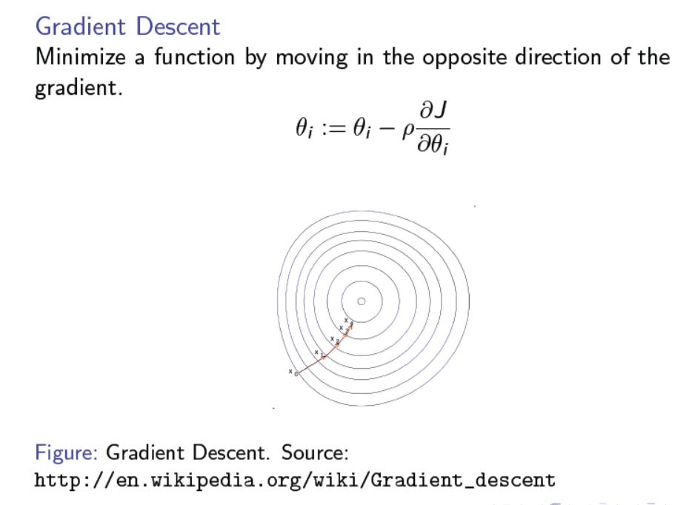

Slide 30
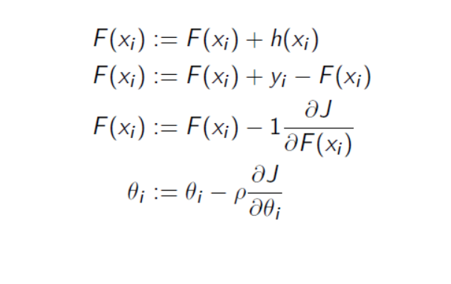
How is it related to gradient descent?

Slide 31
